Slide 1
Airbnb Pricing & Location Analysis
Tableau project
SANDRA A

Slide 2
introduction
Analyze how pricing, location and property features affect Airbnb listing & improve pricing strategy

Slide 3
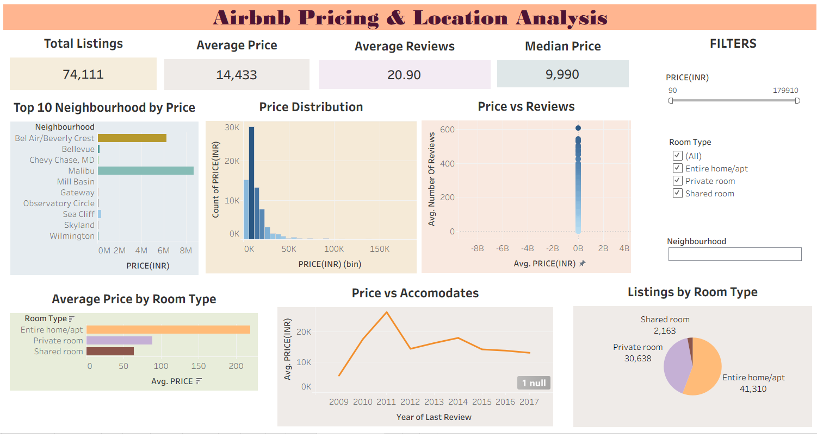

Slide 4
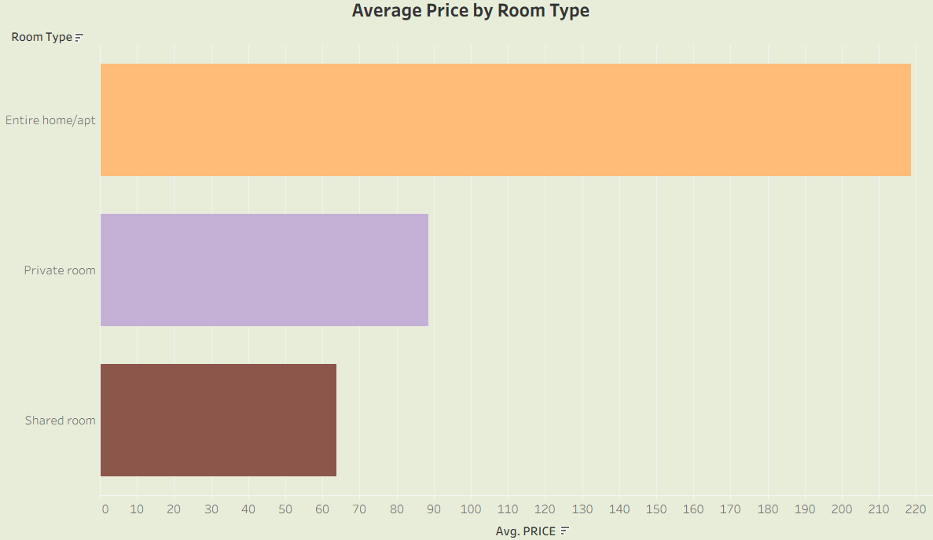
analysis
AVERAGE PRICE BY ROOM TYPE
Finding: Entire home/apt has the highest average price; shared rooms lowest
Insight: Room type strongly influences pricing
Suggestion: Hosts can maximize revenue by offering entire homes in premium areas

Slide 5
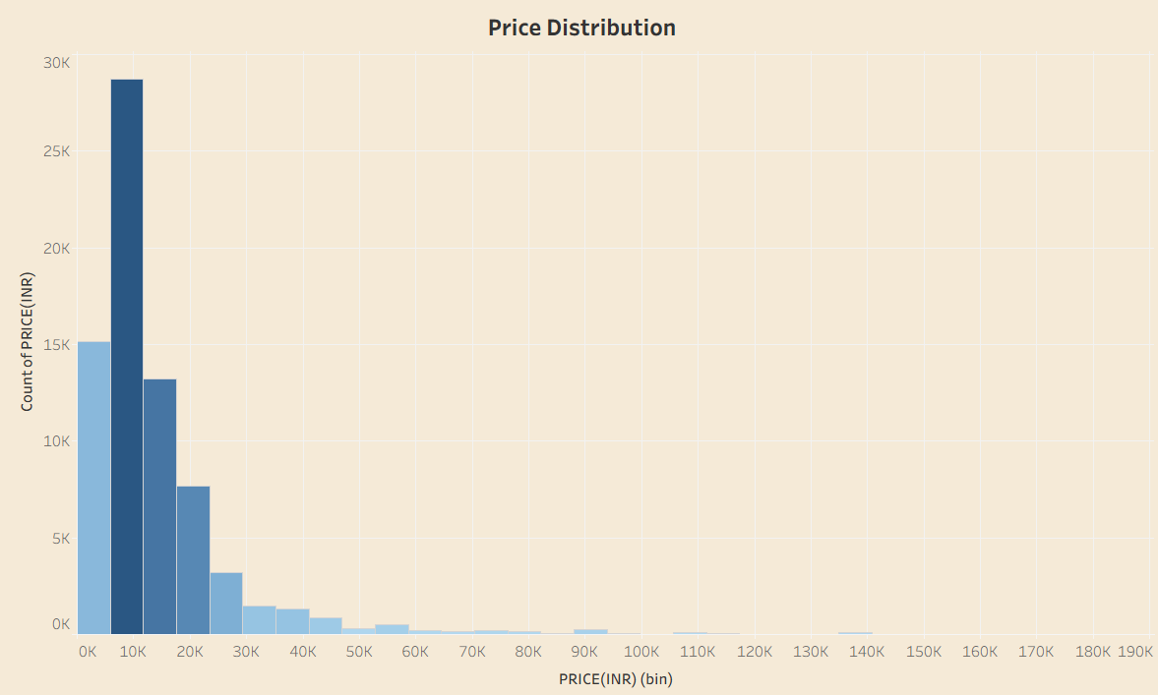
Price Distribution
Finding: Most listings cluster in lower price ranges
Insight: Market is dominated by affordable options, with few luxury outliers
Suggestion: Position premium listings carefully to stand out

Slide 6
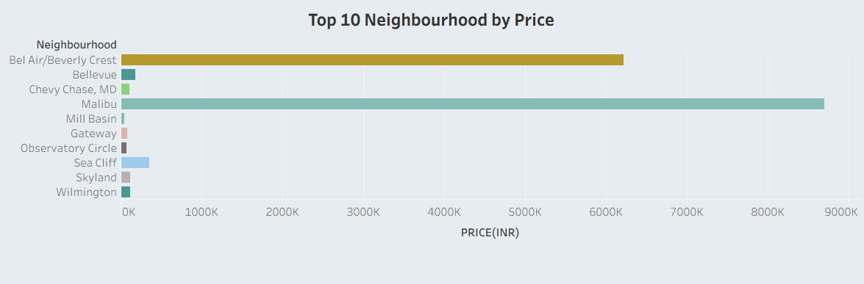
Top 10 Neighborhoods by Price
Finding: Malibu leads with the highest prices; other premium area is Bel Air
Insight: Location is a major determinant of pricing power
Suggestion: Focus marketing on premium neighborhoods to attract high‑spending customers

Slide 7
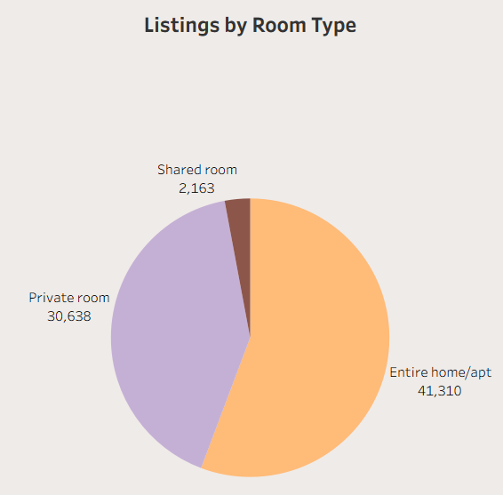
Listings by Room Type
Finding: Entire homes/apt dominate (41,310), followed by private rooms (30,638)
Insight: Market preference leans toward full property rentals
Suggestion: Hosts should align offerings with demand for entire homes

Slide 8
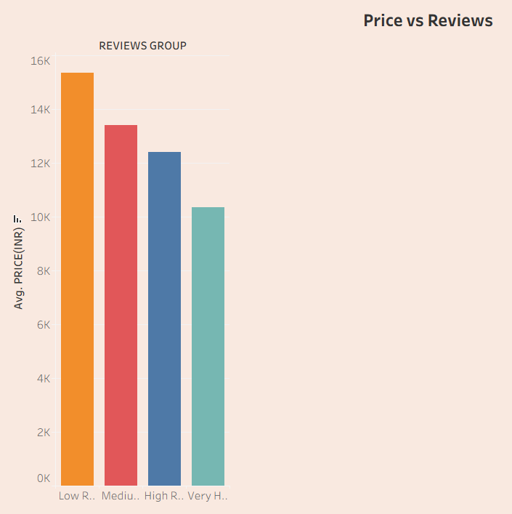
Price vs Reviews
Finding: Higher‑priced listings tend to have fewer reviews
Insight:
Price sensitivity affects customer engagement
Higher‑priced listings attract fewer reviews, while affordable ones gain more engagement
Suggestion: Balance pricing with customer experience to drive reviews

Slide 9
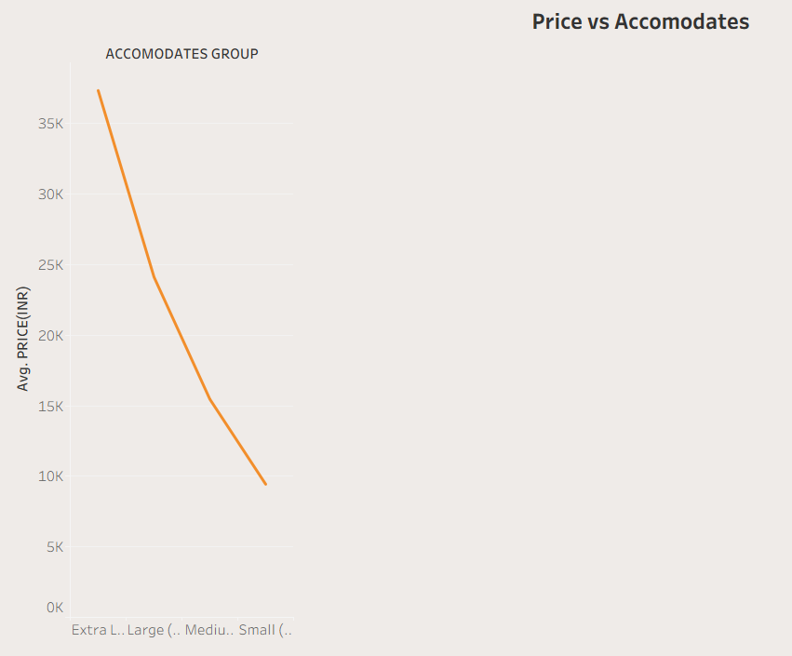
Price vs Accommodates
Finding: Prices steadily drop as capacity decreases, with Small listings (~₹8K–10K) lowest
Insight: Larger accommodations are positioned as premium, while smaller ones dominate affordability
Suggestion:
Market Extra Large listings as luxury experiences to justify premium pricing
Focus pricing strategy on Medium/Large groups (~₹15K–20K) where demand and affordability intersect
Notes:
Extra large : 37k

Slide 10
findings
Pricing is highly influenced by room type and neighborhood
Market is dominated by affordable listings, but premium areas like Malibu command much higher prices
Entire homes are most popular, aligning with customer preference for privacy
Higher prices correlate with fewer reviews, showing price sensitivity

Slide 11
Suggestions
Hosts: Adjust pricing strategies based on room type and location demand
Businesses: Target premium neighborhoods for luxury offerings

Slide 12
conclusion
Airbnb pricing is shaped by room type, neighborhood, and accommodation group. Entire homes in premium areas command the highest prices, while affordable listings dominate overall supply. To optimize performance, hosts and businesses must balance pricing with customer engagement, expand offerings in high‑demand neighborhoods, and align with market preferences for entire homes.
Notes:
Balance pricing with customer reviews.
Offer more listings in high‑demand neighborhoods.
Focus on entire homes, since they match market preference

Slide 13


